Slide 1
Chapter 3
The Fundamentals:
Algorithms
The Integers

Slide 2
Objectives
Algorithms
The Growth of Functions
Complexity of Algorithms
The Integers and Division
Primes and Greatest Common Divisors
Integers and Algorithms

Slide 3
3.1- Algorithms
An algorithm is a finite set of precise instructions for performing a computation or for solving a problem.
Specifying an algorithm: natural language/ pseudocode
Pseudocode for Finding the Maximum Element in a Finite Sequence
Procedure max (a₁,a₂,a₃,…,a_{n}: integers)
max:=a₁
for i:=2 to n
if max < a_{i} then max:= a_{i}
{max is the largest element}

Slide 4
Properties of an algorithm
Input
Output
Definiteness - tính rõ ràng
Correctness - tính chính xác
Finiteness - tính hữu hạn
Effectiveness - tính hiệu qủa
Generality - tính tổng quát

Slide 5
The Linear Search (tìm tuyến tính)
Procedure linear search (x: integer, a₁,a₂,…,a_{n} :distinct integers)
i:=1
while i ≤ n and x ≠ a_{i}
i:=i+1
if i ≤ n then location:= i
else location:=0
{location is the subscript of the term that equals x, or is 0 if x is not found}

Slide 6
The Binary Search (tìm nhị phân)
procedure binary search ( x:integer, a₁,a₂,…,a_{n} : increasing integers)
i:=1 { i is left endpoint of search interval}
j:=n { j is right endpoint of search interval}
while i<j
begin
m:= ⎣(i+j)/2⎦
if x>a_{m} then i:=m+1
else j:= m
end
if x=a_{i} then location := i
else location:= 0
{location is the subscript of the term that equals x, or is 0 if x is not found}

Slide 7
Sorting (sắp xếp)
Putting elements into a list in which the elements are in increasing order.
There are some sorting algorithms
Bubble sort
Insertion sort
Selection sort (exercise p. 178)
Binary insertion sort (exercise p. 179)
Shaker sort (exercise p.259)
Merge sort and quick sort (section 4.4)
Tournament sort (10.2)

Slide 8
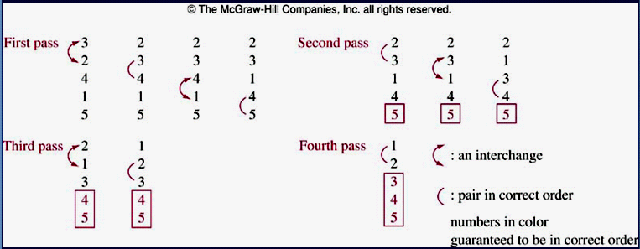
Bubble Sort (nổi bọt)
procedure buble sort (a₁,a₂,…,a_{n} :real numbers with n ≥ 2)
for i:= 1 to n-1
for j:=1 to n- i
if a_{j} > a_{j+1} then interchange a_{j} and a_{j+1}
{a₁,a₂,…,a_{n} are sorted}

Slide 9
Insertion Sort (chèn)
procedure insertion sort (a₁,a₂,…,a_{n} :real numbers with n ≥ 2)
for j:= 2 to n { j: position of the examined element }
begin
{ finding out the right position of a_{j} }
i:=1
while a_{j} > a_{i} i:= i+1
m:=a_{j} { save a_{j} }
{ moving j-i elements backward }
for k:=0 to j-i-1 a_{j-k}:=a_{j-k-1}
{move a_{j} to the position i}
a_{i}:= m
end
{a₁,a₂,…,a_{n} are sorted} It is usually not the most efficient
a: 1 2 3 6 7 8 5 9 12 11
j= 7
i=4
m=5
a: 1 2 3 6 7 8 5 9 12 11
a: 1 2 3 6 6 7 8 9 12 11
a: 1 2 3 5 6 7 8 9 12 11

Slide 10
Greedy Algorithm – Giải thuật tham
They are usually used to solve optimization problems: Finding out a solution to the given problem that either minimizes or maximizes the value of some parameter.
Selecting the best choice at each step, instead of considering all sequences of steps that may lead to an optimal solution.
Some problems:
  Finding a route between two cities with smallest total mileage ( number of miles that a person passed).
  Determining a way to encode messages using the fewest bits possible.
  Finding a set of fiber links between network nodes using the least amount of fiber.

Slide 11
3.2- The Growth of Functions
The complexity of an algorithm that acts on a sequence depends on the number of elements of sequence.
The growth of a function is an approach that help selecting the right algorithm to solve a problem among some of them.
Big-O notation is a mathematical representation of the growth of a function.

Slide 12
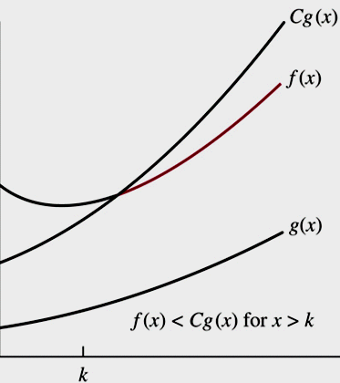
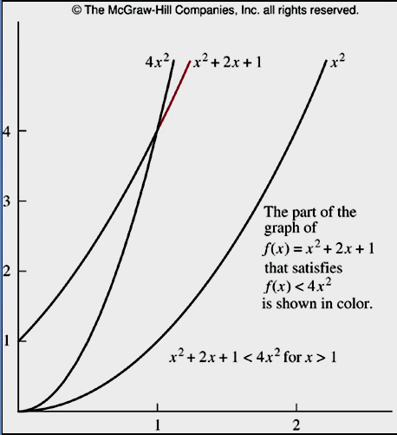
3.2.1-Big-O Notation
Definition:
Let f and g be functions from the set of integers or the set of real numbers to the set of real numbers. We say that f(x) is O(g(x)) if there are constants C and k such that |f(x)| ≤ C|g(x)| whenever x>k
Example: Show that f(x)=x² + 2x +1 is O(x²)
Examine with x>1 ➔ x² >x
➔ f(x)=x² + 2x +1 < x² + 2x² + x²
➔ f(x) < 4x²
➔ Let g(x)= x²
➔ C=4, k=1, |f(x)| ≤ C|g(x)|
➔f(x) is O(x²)

Slide 13
Big-O: Theorem 1
Let f(x)=a_{n}x^{n} + a_{n-1}x^{n-1}+…+a₁x+a₀, where a₀,a₁,…,a_{n} are real number, then f(x) is O(x^{n})
If x>1
|f(x)| =| a_{n}x^{n} + a_{n-1}x^{n-1}+…+a₁x+a₀|
≤ | a_{n}x^{n} |+|a_{n-1}x^{n-1}|+…+|a₁x|+|a₀| { triangle inequality }
≤ x^{n} (| a_{n} |+|a_{n-1}x^{n-1}/x^{n}|+…+|a₁x/x^{n}|+|a₀/x^{n}|)
≤ x^{n} (| a_{n} |+|a_{n-1}/x|+…+|a₁/x^{n-1}|+|a₀/x^{n}|)
≤ x^{n} (| a_{n} |+|a_{n-1}|+…+|a₁|+|a₀|)
Let C= | a_{n} |+|a_{n-1}|+…+|a₁|+|a₀|
|f(x)| ≤ Cx^{n}
➔ f(x) = O (x^{n})

Slide 14
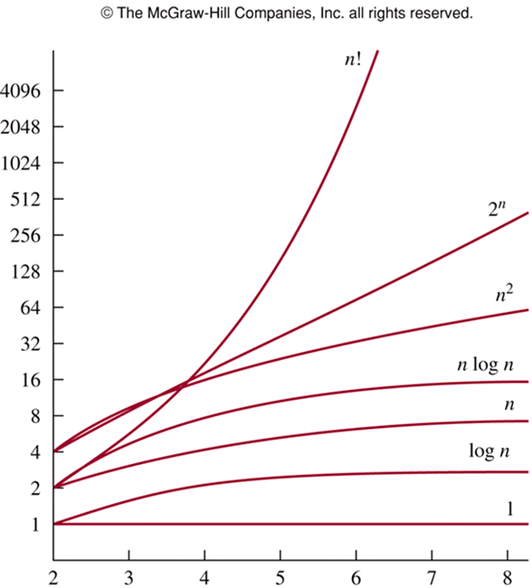
The Growth of Combinations of Functions

Slide 15
Big-O : Theorems
Theorem 2:
f₁(x)=O(g₁(x)) ^ f₂(x)=O(g₂(x))
→ (f₁+f₂)(x) = O(max(|g₁(x)|,|g₂(x)|))
Theorem 3:
f₁(x)=O(g₁(x)) ^ f₂(x)=O(g₂(x))
→ (f₁f₂)(x) = O(g₁g₂(x)))
Corollary (hệ quả) 1:
f₁(x)=O(g (x)) ^ f₂(x)=O(g (x)) → (f₁+f₂)(x) = O(g(x))

Slide 16
3.2.2- Big-Omega and Big-Theta Notation
Big-O does not provide the lower bound for the size of f(x)
Big-Ω, Big- θ were introduced by Donald Knuth in the 1970s
Big-Ω provides the lower bound for the size of f(x)
Big- θ provides the upper bound and lower bound on the size of f(x)

Slide 17
Big-Omega and Big-Theta Notation
Definitions
  ∃c>0,k x ≥ k ^ |f(x)| ≥ C|(g(x)| → |f(x)| = Ω(g(x))
  f(x)= O(g(x)) ^ f(x)= Ω(g(x)) → f(x) = θ(g(x))
  If f(x) = θ(g(x)) then f(x) is of order (có bậc/loại là) g(x)
Show that f(x)=1+2+…+n is θ(n²)
Examining x>0
f(x)=1+2+…+n = n(n+1)/2 = (n² +n) /2
f(x) ≤ (2n²)/2
f(x) ≤ n²
Let c₁=1/2, c₂=1, g(x)= n²
c₁g(x) ≤ f(x) ≤ c₂g(x)
f(x) = θ (n²) with x>0

Slide 18
Big-Omega and Big-Theta Notation
Theorem 4
  Let f(x)=a_{n}x^{n} + a_{n-1}x^{n-1}+…+a₁x+a₀, where a₀,a₁,…,a_{n} are real number, then f(x) is of order x^{n}
From theorem 1 we had:
With x> 1, C= | a_{n} |+|a_{n-1}|+…+|a₁|+|a₀|
|f(x)| ≤ Cx^{n},…
C’(x^{n}) ≤ |f(x)| ≤ C(x^{n})
f(x) = θ(x^{n})

Slide 19
3.3- Complexity of Algorithms
Computational complexity = Time complexity + space complexity.
Time complexity can be expressed in terms of the number of operations used by the algorithm.
  Average-case complexity
  Worst-case complexity
Space complexity will not be considered.

Slide 20
Demo 1
Describe the time complexity of the algorithm for finding the largest element in a set:
Procedure max ( a₁,a₂,…,a_{n} : integers)
max:= a₁
for i:=2 to n
If max < a_{i} then max:= a_{i}
i | Number of comparisons
2 | 2
3 | 2
… | 2
n | 2
n+1 | 1, max< a_{i} is omitted
2(n-1) +1 = 2n-1
comparisions
Time Complexity is θ(n)

Slide 21
Demo 2
Describe the average-case time complexity of the linear-search algorithm :
Procedure linear search (x: integer, a₁,a₂,…,a_{n} :distinct integers)
i:=1
while (i ≤ n and x ≠ a_{i}) i:=i+1
if i ≤ n then location:= i
else location:=0
i | Number of comparisons done
1 | 2
2 | 4
…
n | 2n
n+1 | 1, x ≠ a_{i} is omitted
Avg-Complexity= [(2+4+6+…+2n) ]/n +1 +1
= [2(1+2+3+…+n) /n+2
= [2n(n+1)/2]/n + 2
=[n(n+1)]/n + 2
= n+1 + 2 = n+3
= θ(n)
See demonstrations about the worst-case complexity: Examples 5,6 pages 195, 196

Slide 22
Understanding the Complexity of Algorithms
Complexity | Terminology | Problem class
Θ(1) | Constant complexity | Tractable (dễ), class P
Θ(log n) | Logarithmic complexity | Class P
Θ(n) | Linear complexity | Class P
Θ(n logn) | n log n complexity | Class P
Θ(n^{b}) , b1, integer | Polynominal complexity | Intractable, class NP
Θ(b^{n}), b>1 | Exponential complexity
Θ(n!) | Factorial complexity
NP : Non-deterministic Polynomial time
Notes:
Vấn đề “NP vs P”
Many solvable problems are believed to have the property that no algorithm with polynomial worst-case time complexity solves them, but that a solution, if known, can be checked in polynomial time. Problems for which a solution can be checked in polynomial time are said to belong to the class NP.

Slide 23
3.4- The Integers and Division
Definition: If a and b are integers with a ≠ 0, we say that a divides b if there is an integer c such that b=ac.
When a divides b, we say that:
a is a factor (thừa số, divisor – số chia, ước số) of b
b is a multiple (bội số) of a
Notation: a|b : a divides b ałb : a does not divide b
Example:
3ł7 because 7/3 is not an integer
3|12 because 12/3=4 , remainder=0
Corollary 1:
a|b ^ a|c → a|(mb+nc), m,n are integers

Slide 24
The Division Algorithm
Theorem 2: Division Algorithm: Let a be an integer and d a positive integer. Then there are unique integers q and r, with 0 ≤ r<d, such that a=dq+r
d: divisor , r : remainder, q: quotient (thương số)
Note: r can not be negative
Definition: a=dq+r
a: dividend d: divisor
q: quotient (thương số) r : remainder,
q= a div d r = a mod d
Example:
101 is divided by 11 :101 = 11.9 + 2 ➔ q=9, r=2
-11 is divided by 3 : 3(-4)+ 1 ➔ q=-4, r=1
No OK : -11 is divided by 3 : 3(-3)-2 ➔ q=-3, r = -2

Slide 25
Modular Arithmetic – Phép toán đồng dư
Definition: a, b: integers, m: positive integer.
a is called congruent (đồng dạng) to b modulo m if m|a-b
Notations:
a ≡ b (mod m), a is congruent to b modulo m
a ≠ b (mod m), a is not congruent to b mod m
Examples:
15 is congruent to 6 modulo 3 because 3|15-6
15 is not congruent to 7 modulo 3 because 3 ł15-7

Slide 26
Modular Arithmetic – Phép toán đồng dư
Theorem 3
a,b: integers, m: positive integer
a ≡ b (mod m) ↔ a mod m = b mod m
Proof
(1) a ≡ b (mod m) → a mod m = b mod m
a ≡ b (mod m) → m| a-b → a-b= km→ a=b + km
→ a mod m = (b + km) mod m
→ a mod m = b mod m { km mod m = 0 }
(2) a mod m = b mod m → a ≡ b (mod m)
a = k1m + c ^ b=k2m + c → a-b = (k1-k2) m { suppose a>b)
= km { k= k1-k2}
→ m| a-b ➔ a= b (mod m)

Slide 27
Modular Arithmetic…
Theorem 4
a,b: integers, m: positive integer
a and b are congruent modulo m if and only if there is an integer k such that a = b + km
Proof
(1) a ≡ b (mod m) → a = b + km
a ≡ b (mod m) → m| a-b → a-b= km { from definition of division}
(2) a = b + km → a ≡ b (mod m)
a = b + km → a-b=km → m | a-b → a ≡ b (mod m)

Slide 28
Modular Arithmetic…
Theorem 5
m: positive integer
a ≡ b (mod m) ^ c ≡ d (mod m) →
a+c ≡ b+d (mod m) ^ ac ≡ bd (mod m)
Proof : See page 204
Corollary 2:
m : positive integer, a,b : integers
(a+b) mod m = ((a mod m) + (b mod m)) mod m
ab mod m = ((a mod m)(b mod m)) mod m
Proof: page 205

Slide 29
Applications of Congruences
Hashing Function: H(k) = k mod m
Using in searching data tin memory.
k: data searched, m : memory block
Examples:
H(064212848) mod 111= 14
H(037149212) mod 111= 65
Collision: H(k₁) = H(k₂). For example, H(107405723) = 14

Slide 30
Applications of Congruences
Pseudo-random Numbers x_{n+1}=(ax_{n}+c) mod m
a: multiplier, c: increment, x₀: seed
with 2 ≤ a<m, 0 ≤ c<m, 0 ≤ x₀<m
Examples:
m=9 ➔ random numbers: 0..8
a= 7, c=4, x₀=3
Result: Page 207

Slide 31
Applications of Congruences
Cryptography: letter 1 → letter 2
Examples: shift cipher with k – mật mã dịch k ký tự
f(p) =(p+k) mod 26 → f⁻¹(p)=(p-k) mod 26
Sender: (encoding)
Message: “ABC” , k=3
Using f(p) = (p+3) mod 26 // 26 characters
ABC ➔ 0 1 2 → 3 4 5 ➔ DEF
Receiver: (decoding)
DEF ➔ 3 4 5
Using f⁻¹(p) = (p-3) mod 26
3 4 5 ➔ 0 1 2 ➔ ABC

Slide 32
3.5- Primes and Greatest Common Divisors
Definition 1:
A positive integer p greater than 1 is called prime ( số nguyên tố) if the only positive factors are 1 and p
A positive integer that is greater than 1 and is not prime is called composite ( hợp số)
Examples:
Primes: 2 3 5 7 11
Composites: 4 6 8 9
Finding very large prime: test for supercomputer

Slide 33
Primes…
Theorem 1- The fundamental theorem of arithmetic:
Every positive integer greater than 1 can be written uniquely as a prime or as the product of two or more primes where the prime factors are written in order of nondecreasing size
Examples:
Primes: 37
Composite: 100 = 2.2.5.5 = 2²5²
999 = 3.3.3.37 = 3³37

Slide 34
Primes…
Converting a number to prime factors
Examples: 7007
Try it to 2,3,5 : 7007 can not divided by 2,3,5
7007 : 7
1001 : 7
143: 11
13: 13
0
➔ 7007 = 7².11.13

Slide 35
Primes…
Theorem 2: If n is a composite, then n has a prime divisor less than or equal to √ ̅̅n
Proof:
n is a composite ➔ n = ab in which a or b is a prime
If (a> √ ̅̅n ^ b> √ ̅̅n) → ab>n ➔ false
➔ Prime divisor of n less than or equal to √ ̅̅n

Slide 36
Primes…
Theorem 3: There are infinite many primes
Proof: page 212
Theorem 4: The prime number theorem:
The ratio of the number of primes not exceeding x and x/ln x approaches 1 and grows with bound ( ln x: natural logarithm of x)
See page 213
Example:
x= 10¹⁰⁰⁰ → The odds that an integer near 10¹⁰⁰⁰ is prime are approximately 1/ln 10¹⁰⁰⁰ ~ 1/2300

Slide 37
Primes: Conjecture and Open Problem
Các phỏng đoán và bài toán chưa có lời giải
See pages: 214, 215
3x + 1 conjecture
Twin prime conjecture: there are infinitely many twin primes

Slide 38
Greatest Common Divisors and Least Common Multiples
Definition 2:
Let a, b be integers, not both zero. The largest integer d such that d|a and d|b is called the greatest common divisor of a and b.
Notation: gcd(a,b)
Example: gcd(24,36)=?
Divisors of 24: 2 3 4 6 8 12 = 2³3¹
Divisors of 36: 2 3 4 6 9 12 18 = 2²3²
gcd(24,36)=12 = 2²3¹ // Get factors having minimum power

Slide 39
Greatest Common Divisors and Least Common Multiples
Definition 3:
The integers a, b are relatively prime if their greatest common divisor is 1
Example:
gcd(3,7)=1 ➔ 3,7 are relatively prime
gcd (17,22)=1 ➔ 17,22 are relatively prime
gcd(17,34) = 17 ➔ 17, 34 are not relatively prime

Slide 40
Greatest Common Divisors and Least Common Multiples
Definition 4:
The integers a₁,a₂,a₃,…,a_{n} are pairwise relatively prime if gcd(a_{i},a_{j})=1 whenever 1 ≤ i<j ≤ n
Example:
7 10 11 17 23 are pairwise relatively prime
7 10 11 16 24 are not pairwise relatively prime
➔ Adjacent number of every composite in sequence must be a prime.

Slide 41
Greatest Common Divisors and Least Common Multiples
Definition 5:
The Least common multiple of the positive integer a and b is the smallest integer that is divisible by both a and b
Notation: lcm(a,b)
Example:
lcm(12,36) = 36 lcm(7,11) = 77
lcm (2³3⁵7², 2⁴3³) = 2⁴3⁵7²
2³3⁵7², 2⁴3³7⁰ ➔ 2⁴3⁵7² // get maximum power

Slide 42
Greatest Common Divisors and Least Common Multiples
Theorem 5:
Let a, b be positive integers then
ab= gcd(a,b). lcm(a,b)
Example: gcd(8, 12) = 4 lcm(8,12)=24 ➔ 8.12 = 4.24
Proof: Based on analyzing a, b to prime factors to get gcd(a,b) and lcm(a,b)
➔ ab=gcd(a,b). lcm(a,b)

Slide 43
3.6- Integers and Algorithms
Representations of Integers
Algorithms for Integer Operations
Modular Exponentiation
Euclid Algorithm

Slide 44
Representations of Integers
Theorem 1:
Let b be a positive integer greater than 1. Then if n is a positive integer, it can be expressed uniquely in the form
n= a_{k}b^{k} + a_{k-1}b^{k-1}+ … + a₁b + a₀
Where k is a nonnegative integer, a₀,a₁,a₂,…,a_{k} are nonnegative integers less than b and a_{k} ≠ 0
Proof: page 219
Example: (245)₈= 2.8² + 4.8+5 = 165
Common Bases Expansions: Binary, Octal, Decimal, Hexadecimal
Finding expansion of an integer: Pages 219, 220, 221

Slide 45
Algorithm 1: Constructing Base b Expansions
Procedure base b expansion ( n: positive integer)
q:=n
k:=0
while q ≠ 0
begin
a_{k} :=q mod b
q := ⎣q/b⎦
k := k +1
end { The base b expansion of n is (a_{k-1}a_{k-2}…a₁a₀)}

Slide 46
Algorithms for Integer Operations
Algorithm 2: Addition integers in binary format
Algorithm 3: Multiplying integers in binary format
Algorithm 4: Computing div and mod integers
Algorithm 5: Modular Exponentiation

Slide 47
Algorithm 2: Adding of Integers
Complexity: O (n)
procedure add ( a,b: integers)
{ a: (a_{n-1}a_{n-2}…a₁a₀)₂ b: (b_{n-1}b_{n-2}…b₁b₀)₂ }
c:=0
for j:=0 to n-1
Begin
d:= ⎣(a_{j}+b_{j}+c)/2⎦ // next carry of next step
s_{j}= a_{j}+b_{j}+c - 2d // result bit
c:=d // updating new carry to next step
End
s_{n}= c // rightmost bit of result
{ The binary of expansion of the sum is (s_{n}s_{n-1}…s₁s₀)}
1 1 1 0 0
1 1 1 0 (a)
+ 1 0 1 1 (b)
1 1 0 0 1 (s)

Slide 48
Algorithm 3: Multiplying Integers
Complexity: O (n²)
procedure multiply ( a,b: integer)
{ a: (a_{n-1}a_{n-2}…a₁a₀)₂ b: (b_{n-1}b_{n-2}…b₁b₀)₂ }
for j:= 0 to n-1
begin
if b_{j} =1 then c_{j} := a shifted j places
end
{ c₀, c₁, …, c_{n-1} are the partial products }
p := 0
for j:= 0 to n-1
p:=p+c_{j}
{p is the value of ab}
1 1 0 (a)
X 1 0 1 (b)
1 1 0
+ 0 0 0 0
1 1 0 0 0
1 1 1 1 0 (p)
Complexity: O (n)

Slide 49
Algorithm 4: Computing div and mod
procedure division ( a: integer; d: positive integer)
q:=0
r:= |a|
while r ≥ d {quotient= number of times of successive subtractions}
begin
r:= r-d
q := q+1
end
If a<0 and r>0 then {updating remainder when a<0}
begin
r:= d-r
q := -(q+1)
end
{ q = a div d is the quotient, r=a mod d is the remainder}

Slide 50
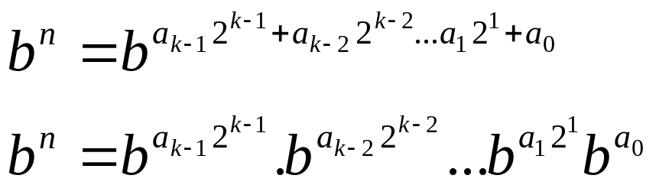
Algorithm 5: Modular Exponentiation
{ b^{n} mod m = ? . Ex: 3⁶⁴⁴ mod 645 = 36 }
procedure mod_ex ( b: integer, n=(a_{k-1}a_{k-2}…a₁a₀)₂, m: positive integer)
x:=1
power := b mod m
for i:=0 to k-1
begin
if a_{i}=1 then x:= (x.power) mod m
power := (power.power) mod m
end
{ x equals b^{n} mod m }
Corollary 2: ab mod m = ((a mod m)(b mod m)) mod m
b^{n} mod m = result of successive factor_{i} mod m

Slide 51
The Euclidean Algorithm
Lemma ( bổ đề): Proof: page 228
Let a= bq+r, where a, b, q, r are integers. Then gcd(a,b) = gcd(b,r)
Example: 287 = 91.3 + 14 ➔gcd(287,91) =gcd(91,14)= 7
procedure gcd(a,b: positive integer)
x:=a
y:=b
while y ≠ 0
begin
r := x mod y
x:=y
y:= r
end {gcd(a,b) is x}

Slide 52
Summary
Algorithms
The Growth of Functions
Complexity of Algorithms
The Integers and Division
Primes and Greatest Common Divisors
Integers and Algorithms

Slide 53
Thanks

